Slide 1
CAD Design Project 3 – Boolean Optimization with Espresso
M11152013 張棨揚

Slide 2
Background
The Espresso is a software package developed at IBM for two-level Boolean function minimization in 1982. The Espresso adopts positional cube notation – a binary encoding technique to process Boolean cubes, a.k.a. implicants and product terms. Combined with the unate recursive paradigm (URP), we are capable of implementing primitive Boolean operations efficiently for 2-level and multilevel logic synthesis.

Slide 3
Rough Comparison of Minimizers
MINI
Iterate EXPAND, REDUCE, RESHAPE
Espresso
Iterate EXPAND, IRREDUNDANT, REDUCE
Espresso guarantees an irredundant cover
Because of the irredundant operator
MINI may return irredundant covers, but can guarantee only minimality w.r.t. single implicant containment

Slide 4
Espresso
It accepts as input a two-level representation of a two-valued (or multiple-valued) Boolean function and algorithms using heuristic Boolean minimization, The default input, and output file formats are compatible with the Berkeley standard format for the physical description of a PLA.
PLA files are expressed in binary, the ON-set of a Boolean function, we mean those minterms which imply the function value is a 1. Likewise, the OFF-set are those terms that imply the function is a 0, and the DC- set (don't care set) are those terms for which the function is unspecified.

Slide 5
Common Keywords
.i [d]
Specifies the number of input variables.
.o [d]
Specifies the number of output functions.
.p [d]
Specifies the number of product terms
.e (.end)
Optionally marks the end of the PLA description.

Slide 6
Common Keywords
.ilb [s1] [s2] . . . [sn]
Gives the names of the binary valued variables. This must come after .i and .o (or after .mv). There must be as many tokens following the key- word as there are input variables.
.ob [s1] [s2] . . . [sn]
Gives the names of the output functions. This must come after .i and .o (or after .mv). There must be as many tokens following the keyword as there are output variables.
.pair [d]
Specifies the number of pairs of variables which will be paired together using two-bit decoders. The rest of the line contains pairs of numbers which specify the binary variables of the PLA which will be paired together.
.phase [s]
[s] is a string of as many 0's or 1's as there are output functions. It specifies which polar- ity of each output function should be used for the minimization

Slide 7
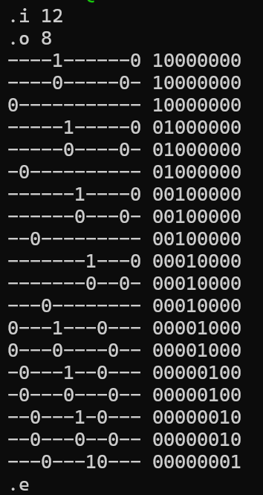
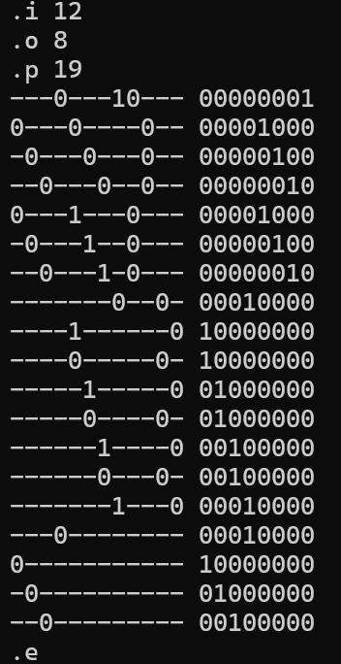
Example
Input 12 variables, output 8 variable and Boolean function , and then use espresso for Boolean Optimization
output

Slide 8
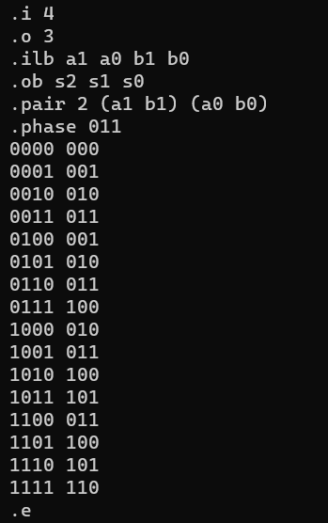
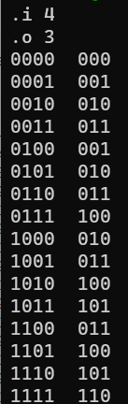
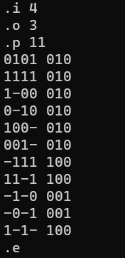
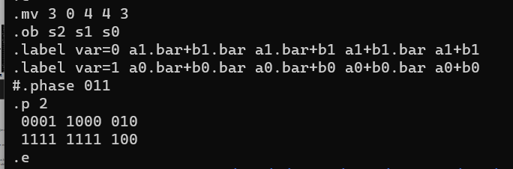
Example
A 2-bit by 2-bit binary adder can be rewritten via .pair and .phase progressions
output
output

Slide 9
Other Keywords
.mv [num_var] [num_binary_var] [d1] . . . [dn]
Specifies the number of variables (num_var), the number of binary variables (num_binary_var), and the size of each of the multiple-valued vari- ables (d1 through dn).
.label var=[d] [s1] [s2][…..]
Specifies the names of the parts of a multiple- valued variable. This must come after .mv. There must be as many tokens following the key- word as there are parts for this variable. Note that the variables are numbered starting from 0.

Slide 10
Other Keywords
.kiss
Sets up for a kiss-style minimization.
.type [s]
Sets the logical interpretation of the character matrix as described below under "Logical Description of a PLA". This keyword must come before any product terms. [s] is one of f, r, fd, fr, dr, or fdr.
.symbolic [s0] [s1] . . . [sn] ; [t0] [t1] . . . [tm]
.symbolic-output [s0] [s1] . . . [sn] ; [t0] [t1] . . . [tm] ;

Slide 11
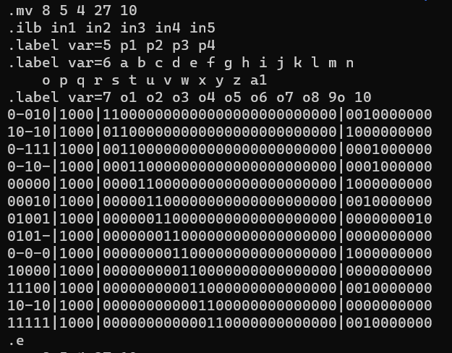
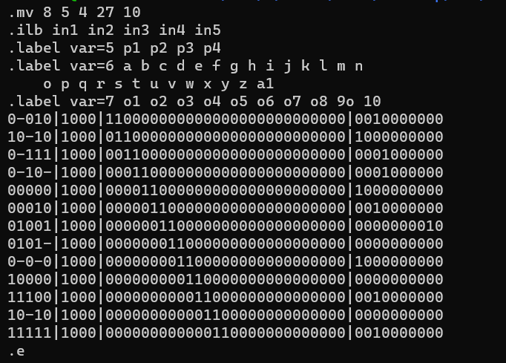
Example
5 binary variables and 3 multiple-valued variables (8 variables total) where the multiple-valued variables have sizes of 4 27 and 10 (note that the last multiple-valued variable is the "output" and also encodes the ON-set, DC-set and OFF-set information).
output

Slide 12
Discussion
Espresso is an application that has been developed for a long time and is still power today. In the past two weeks of testing and observation, we found out it can quickly generate the most appropriate simplification results in both complex instructions and the tedious boolean fuction, through which it can reduce unnecessary product tern and give us the solution after the boolean function is simplified.

Slide 13
Reference
[1] Espresso logic minimizer (Source code)
https://github.com/psksvp/espresso-ab-1.0
[2] Espresso: A Multi-valued PLA minimization (Documentation)
https://ptolemy.berkeley.edu/projects/embedded/pubs/downloads/espresso/index.htm
[3] PLA format description
https://ddd.fit.cvut.cz/www/prj/TT-Min/pla.html
[4] L07_comb_two2.pdf
https://moodle2.ntust.edu.tw/pluginfile.php/224729/mod_resource/content/1/L07_comb_two2.pdf

